Slide 1

Smart Parking Lot
Parking made easier

Slide 2
Table of contents
01
03
02
Main Product Features
Technologies used
The innovations this app offers
Short summary of the technologies used to write the app
Development Method
How was the team organized in development

Slide 3

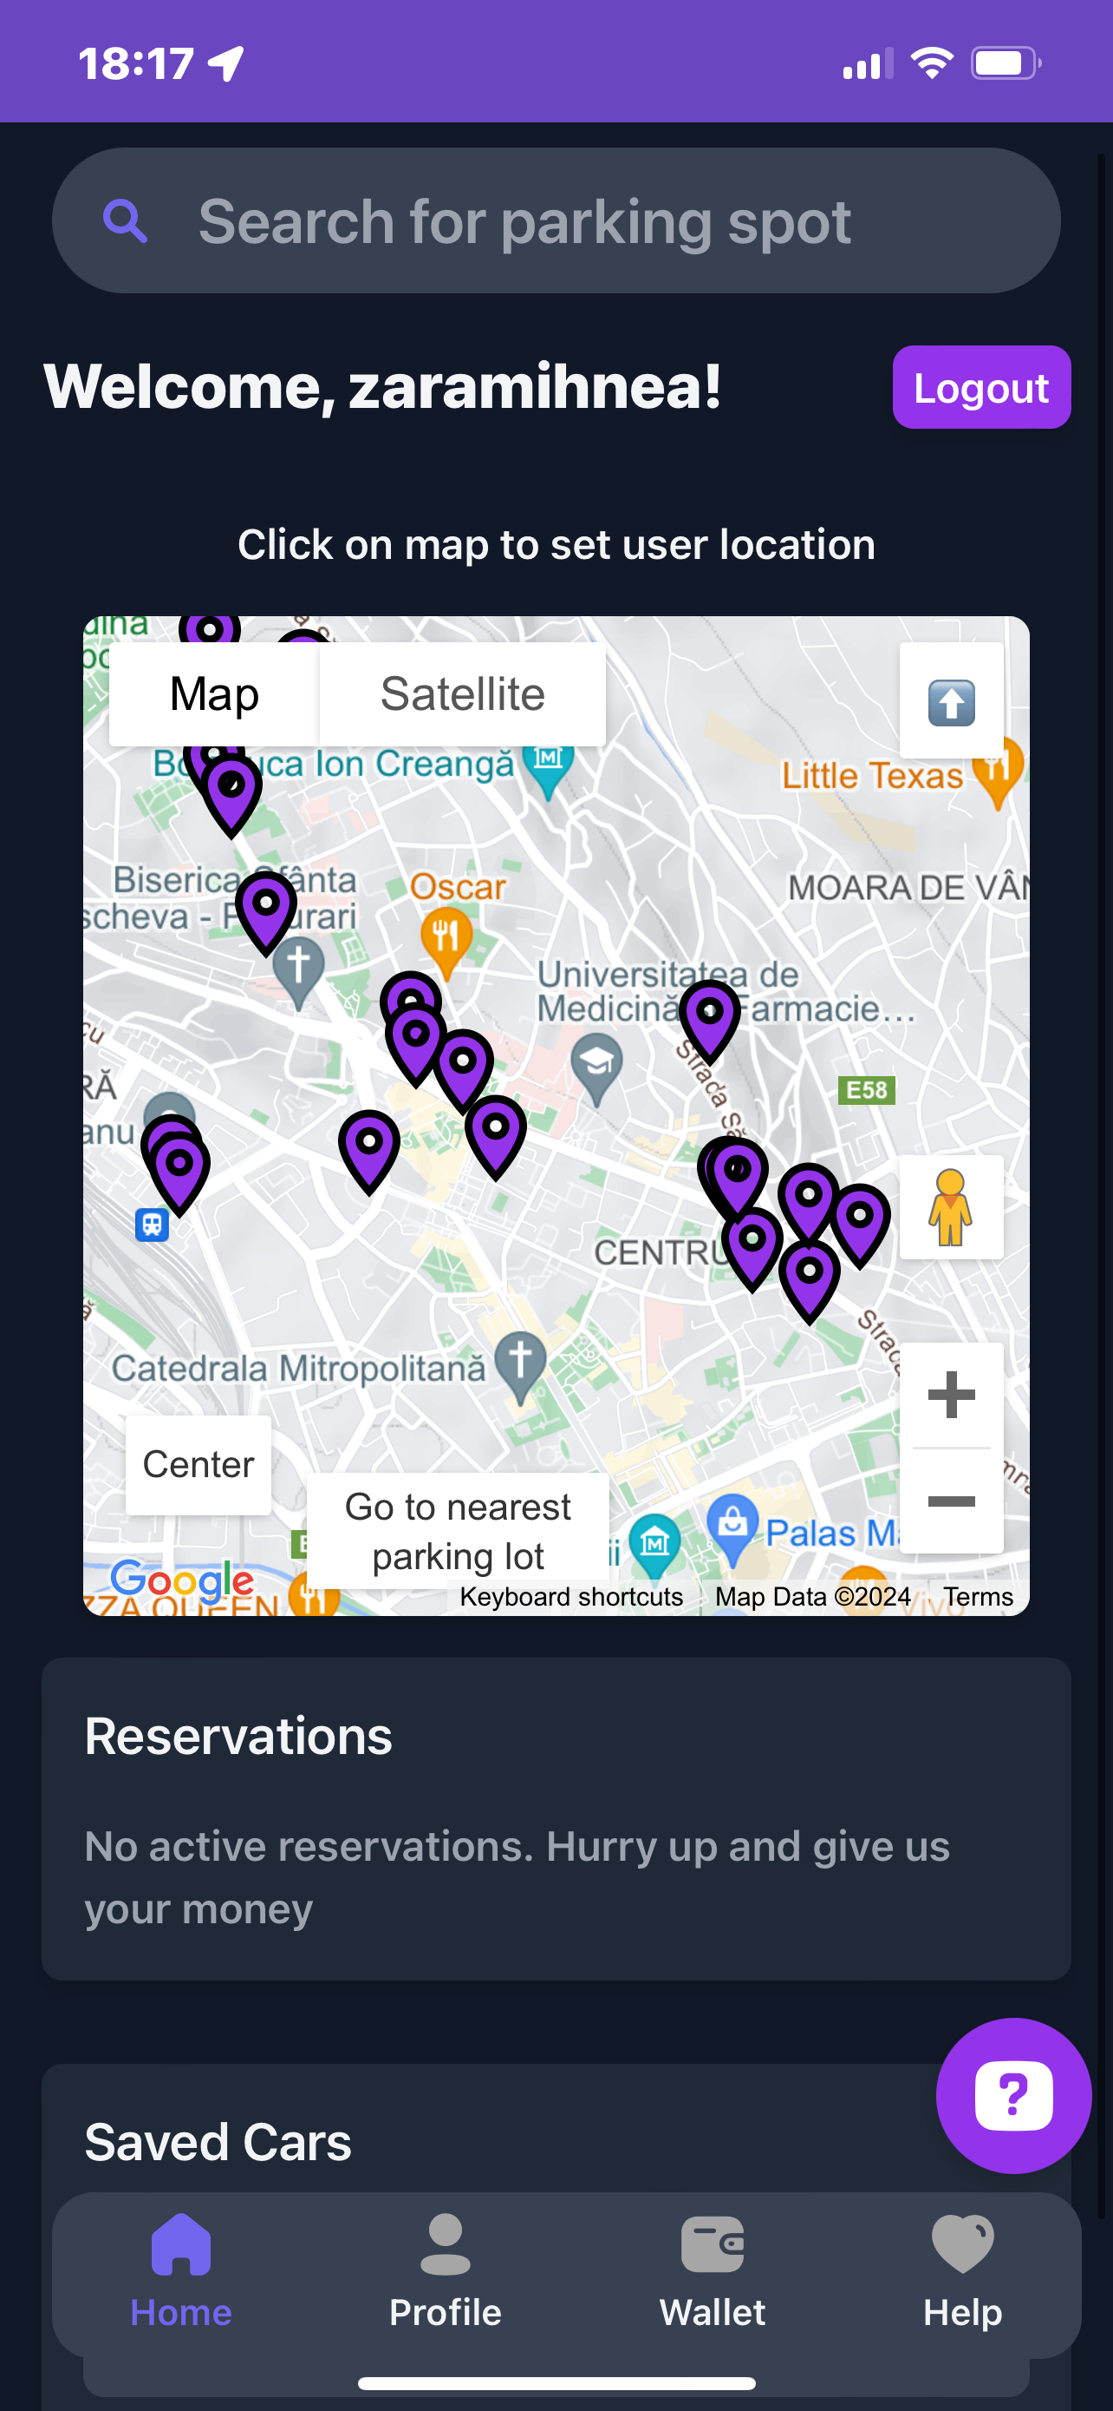
01
Main Product Features

Slide 4
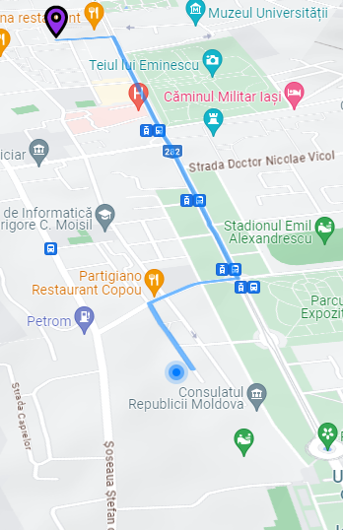
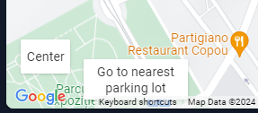
Drive to the nearest parking Lot
Drive to the nearest parking lot and reserve a spot.
We will find the fastest route for you

Slide 5
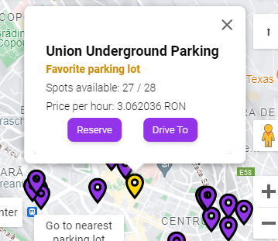
Choose a Lot, Reserve a spot
Pick your desired parking Lot and manually reserve a spot there.

Slide 6
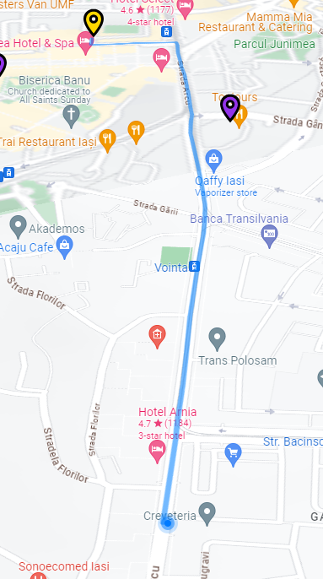
Drive to your spot
Drive to any parking lot after pressing the Drive To button on the desired parking lot marker.
The screen will be following the road ahead to improve the driving experience

Slide 7
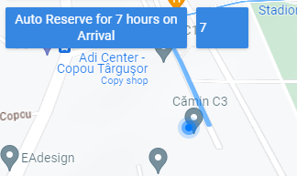
Auto Reserve on Arrival
Make the most out of your reservation time by auto reserving a parking spot on arrival to your desired parking lot.

Slide 8
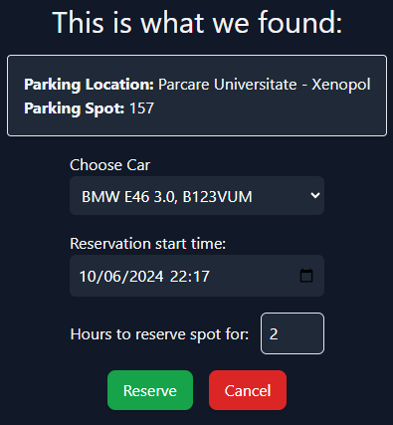
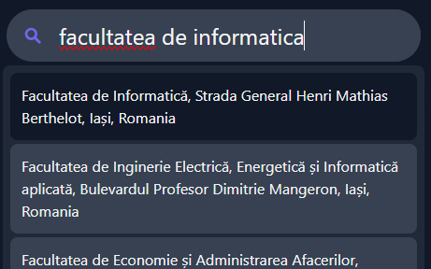
Reserve by Address
Choose your destination, and we will find the Parking Spot closest to your destination for you

Slide 9
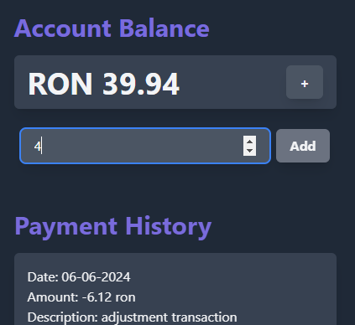
Recharge your account
Charge your account with enough money for your parking needs.

Slide 10
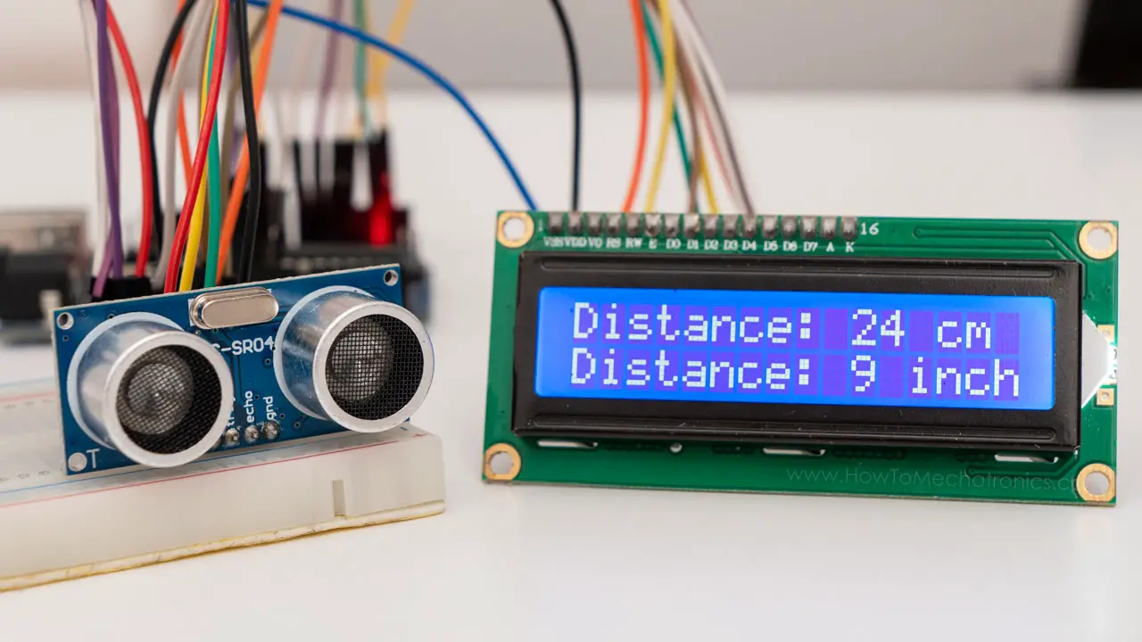
Parking Lot Sensors
- Every parking lot has a distance sensor and a camera
- Admins are notified in the app about unauthorized parking

Slide 11
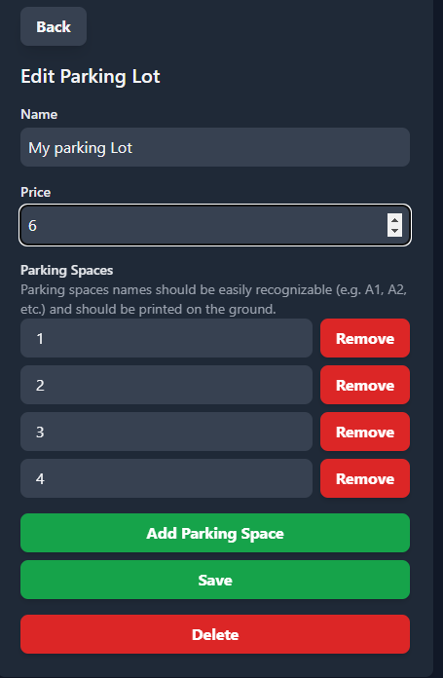
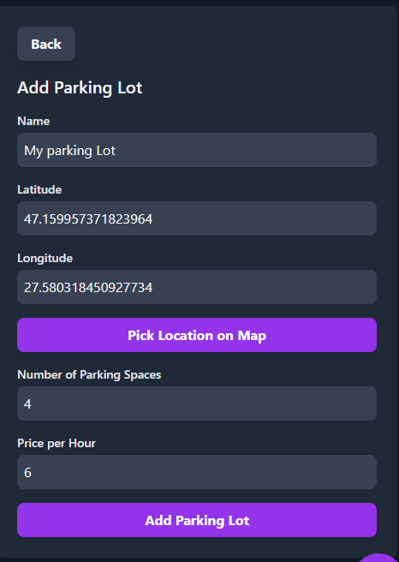
Add, Edit Parking Lots
Parking Lot Administrators will create and manipulate Parking Lots information in the app

Slide 12
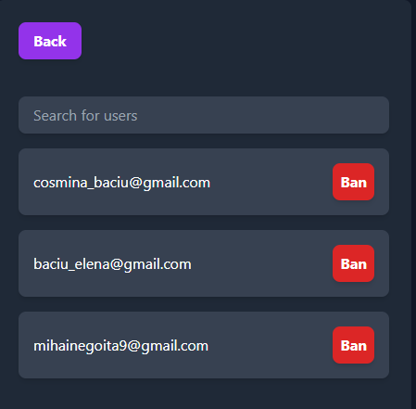
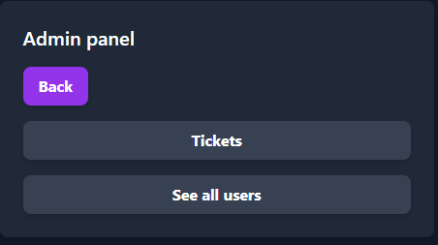
Manipulate users accounts
Application Administrators will receive complaints, questions from users, and ban the malicious ones.

Slide 13
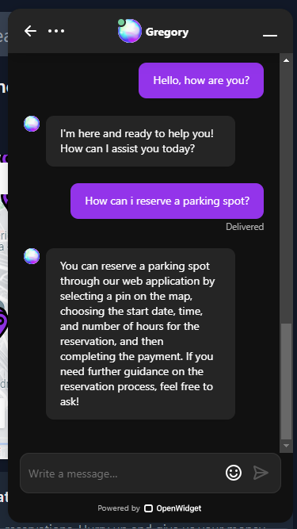
Need Help?
Talk with our built in Chatbot if you need help with using our app

Slide 14
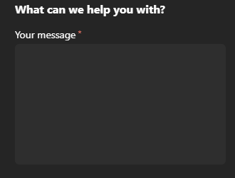
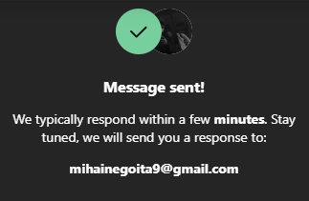
Need Help?
Leave us a message, and we will try to respond as soon as possible

Slide 15


Try our app
email
password
guest@gmail.com
Guest@123

Slide 16

02
Technologies Used

Slide 17
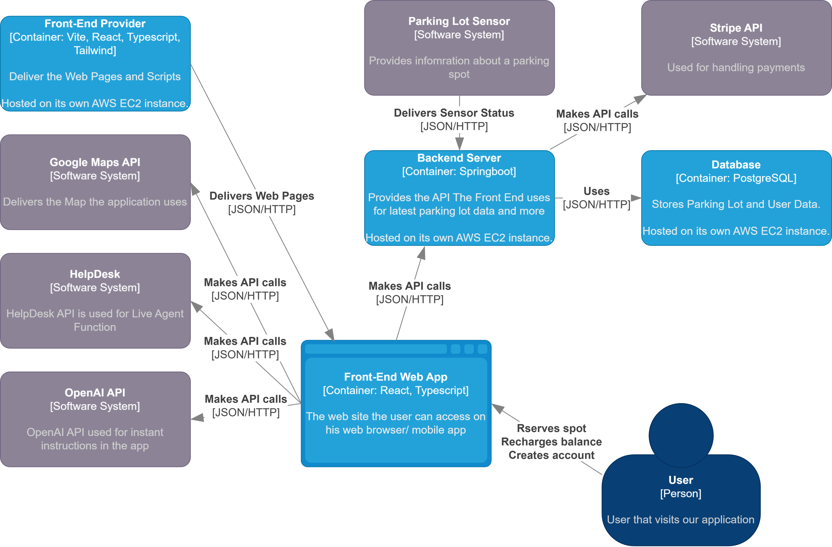

Slide 18
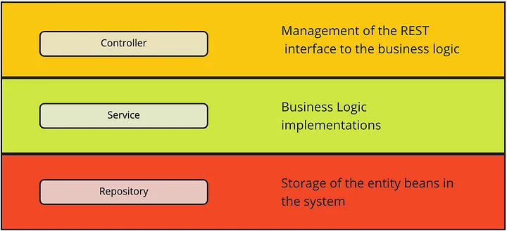
Controller – Service – Repository Pattern
On the back-end server, the Controller – Service – Repository pattern was used for separation of concerns, maintainability, testability, and scalability.

Slide 19

Scalable & Secure
Using EC2 instances allows for easy scaling and deployment, and they can be orchestrated using platforms like Kubernetes.
All communication is done through HTTPS, JWT Tokens are used for authentication, only necessary data is stored.
Stripe Checkout is used to securely accept payments online.

Slide 20
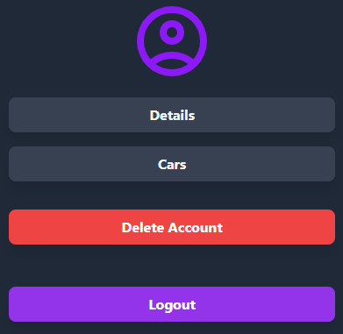
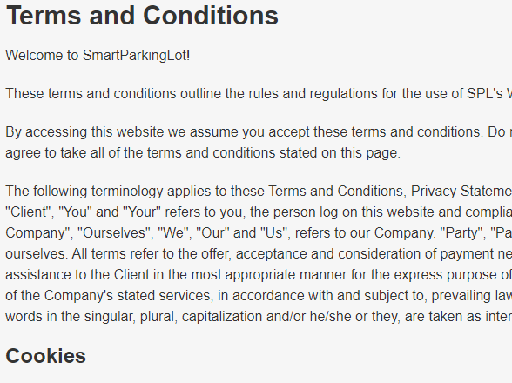
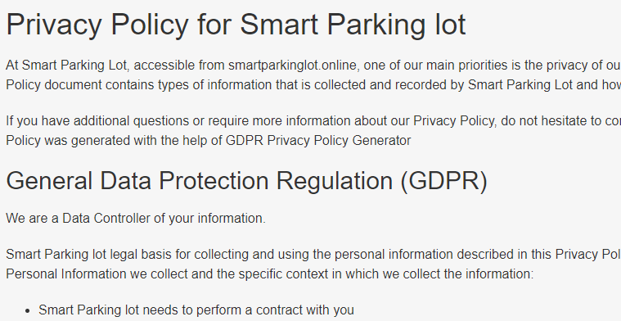
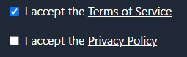



Scalable & Secure
HIPAA & GDPR Compliant

Slide 21
03
Development Method

Slide 22
Teams
Back-End
Front-End
The group was split in 4 groups, each having a Scrum Master
Database
Arduino

Slide 23
Methodologies
Scrum
Kanban
The primary software engineering methodology utilized is Scrum, known for its efficiency and user-friendliness, especially for beginners.
Kanban practices were also implemented, with team members reallocated to support a team lagging behind on its tasks.

Slide 24
Overview
At the start of each sprint, the leaders discussed with the client(professor) and team members, and created tasks to be implemented, and each group member could choose what he wants to implement. During sprints, new ideas were handled, and new tasks made accordingly.
Steps | Week | 1 | 2 | 3 | 4 | 5 | 6 | 7 | 8 | 9 | 10 | 11 | 12
1.1. Leader Creates tasks
1.2. Members choose tasks
1.3. Implement
2.1. Repeat 1.1 – 1.3
3.1. Repeat 1.1 – 1.3
Setup
Sprint #1
Implementation
Sprint #2
Implementation & Integration
Sprint #3

Slide 25
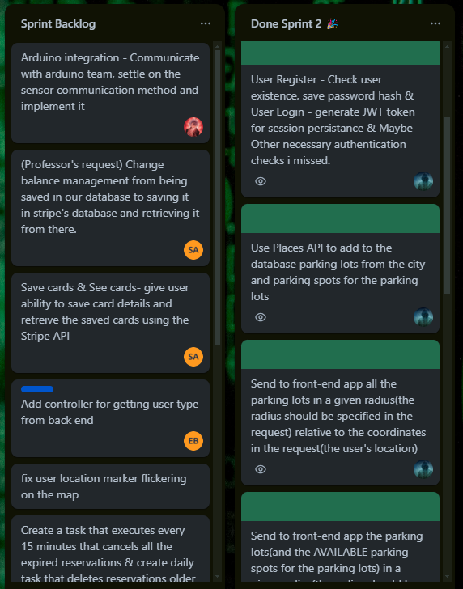
Tools Used
Trello
For simplicity of task creation and allocation, the Trello application was used by the group members to to log the project progress and choose the tasks they preffered to work on.

Slide 26
Tools Used
Google Docs
Github
The Backend API (request – response sequences) was documented on a google docs document to be later used for integration
The project had a main repository every contributing member forked, and the Pull Requests were verified and merged by the Scrum Masters.
Discord
A Discord Server was created for seamless communication between team members. Every team had a dedidicated chat for issue discussions, ideas, project updates, etc.

Slide 27
Development Steps
1. Modelling
2. Implementation
3. Integration
C4 diagrams were created for a a high-level overview of the system and its interactions with external entities
In the implementation step each individual chose tasks to implement
Every team collaborated to integrate every component of the application

Slide 28
Development Steps
4. Deployment
5. Maintenance
The app is hosted on AWS on multiple EC2 instances
After deployment, unexpected bugs or changes to the app are constantly being handled

Slide 29

Thanks!
Do you have any questions?
mihainegoita9@gmail.com
+40 735 535 918

